Slide 1
Introduction to Linux Systems Simulation for autonomous valet parking
Chia-Heng Tu
Dept. of Computer Science and Information Engineering
National Cheng Kung University
Fall 2024

Slide 2
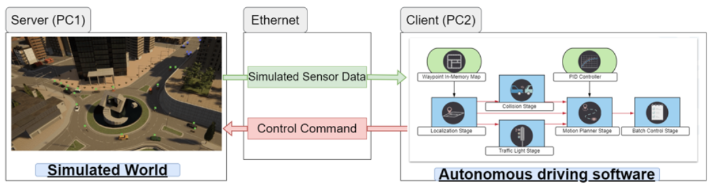
The system of the AVP simulations
PC1 representing a server machine runs the 3D simulation with CARLA
PC2 representing a client machine runs the autonomous driving software, Autoware
The two machines are connected with Gigabit Ethernet to exchange data

Slide 3
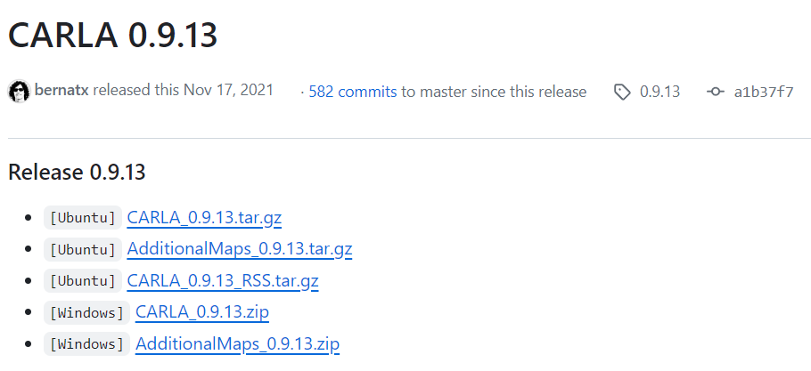
Software Installation on PC1 (Server)
Carla 0.9.13

Slide 4
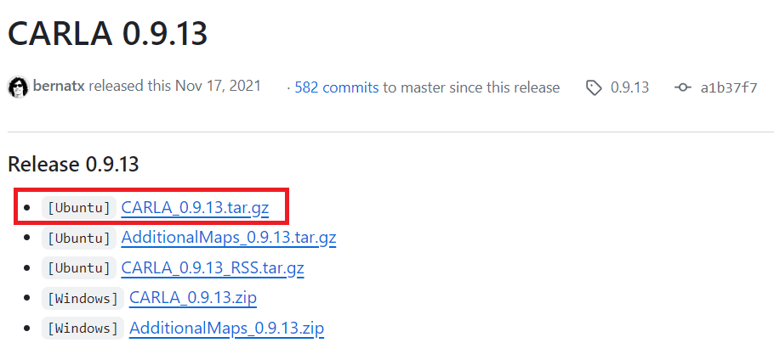
Software Installation on PC2 (Client)
Carla 0.9.13

Slide 5
Installing necessary Python packages
sudo apt install python3-pip
cd ${CARLA_INSTALLATION}/PythonAPI/examples
python3 -m pip install -r requirements.txt

Slide 6
Autoware Installation(Client PC)
cd ~
git clone https://github.com/ChunTing-Wu/Autoware_galactic autoware
cd autoware
./setup-dev-env.sh
mkdir src
vcs import src < autoware.repos

Slide 7
Install required ROS packages(Client PC)
source /opt/ros/galactic/setup.bash
rosdep update --include-eol-distros
rosdep install -y --from-paths src --ignore-src --rosdistro $ROS_DISTRO
colcon build --symlink-install --cmake-args -DCMAKE_BUILD_TYPE=Release

Slide 8
Installing Python packages for Autoware
(Client PC)
sudo apt install ros-galactic-sensor-msgs-py
pip3 install network
pip3 install py_trees
pip3 install tabulate
pip3 install transforms3d

Slide 9
Run the AVP simulation with PC1 & PC2

Slide 10
Customized ROS Bridge(Client PC)
cd ~
git clone https://github.com/ChunTing-Wu/ncku_op_carla_bridge.git
cd ncku_op_carla_bridge

Slide 11
Set up all environment variables(Client PC)
vim ~/.bashrc
export CARLA_ROOT=${HOME}/ncku_carla_simulator
export PYTHONPATH=$PYTHONPATH:${CARLA_ROOT}/PythonAPI
export PYTHONPATH=$PYTHONPATH:${CARLA_ROOT}/PythonAPI/util
export PYTHONPATH=$PYTHONPATH:${CARLA_ROOT}/PythonAPI/carla
export PYTHONPATH=$PYTHONPATH:${CARLA_ROOT}/PythonAPI/carla/agents
export PYTHONPATH=$PYTHONPATH:$CARLA_ROOT/PythonAPI/carla/dist/carla-0.9.13-py3.8-linux-x86_64.egg:$CARLA_ROOT/PythonAPI/carla
export OP_BRIDGE=${HOME}/ncku_op_carla_bridge
export SCENARIO_RUNNER_ROOT=${OP_BRIDGE}/scenario_runner
export LEADERBOARD_ROOT=${OP_BRIDGE}/op_bridge
export TEAM_CODE_ROOT=${OP_BRIDGE}/op_agent

Slide 12
Set up the Simulator Map(Client PC)
Map DownLink (map_name=Town10HD)
Town10HD/pointcloud_map.pcd
lanele2_map.osm
vim ~/ncku_op_carla_bridge/op_agent/start_ros2.sh
15 # source ros env
16 source ${AUTOWARE_PATH}/install/setup.bash
17
18 # launch autoware
19 ros2 launch autoware_launch autoware.launch.xml map_path:=${map_path}/${map_name} vehicle_model:=sample_vehicle sensor_model:=sample_sensor_kit

Slide 13
Set up the Carla Server IP
vim ~/ncku_op_carla_bridge/op_bridge/op_scripts/run_exploration_mode_ros2.sh
export SIMULATOR_LOCAL_HOST="192.168.91.11"
Your PC1 IP

Slide 14
Start the simulation with PC1 & PC2
PC1 run Carla Server
PC2
cd ${HOME}/ncku_op_carla_bridge
sh op_bridge/op_scripts/run_exploration_mode_ros2.sh

Slide 15
Example Video
Video Link (CARLA)
Video Link (Autoware)

Slide 16
Demo
由指定A點自駕至B點程式碼與解釋 50 %（依據老師投影片P25說明AVP的各個時間點的動作分別是什麼）
AVP 錄影 50 % （如果現場Demo則不需要錄影）
Environment Build 10% (Bonus)
以上檔案放入同一資料夾後壓縮上傳 moodle

Slide 17
Notice
因為本次mini project需要一台Server及一台Client，所以本次mini project為兩人一組，請至分組名單登記組員名稱及學號
因為本次mini project對電腦性能要求較高，如果同學有需求，可以填寫時間表到實驗室借用電腦，實驗室會先將環境架好供同學使用

Slide 18
QUESTIONS

